Slide 1
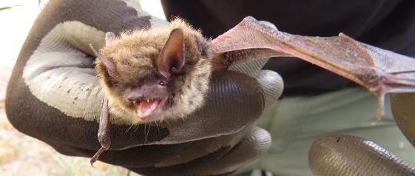

White-Nose Syndrome Response
Photo: M. Marsh
Washington Department of Fish and Wildlife
Lori Salzer – Conservation Biologist* Lori.Salzer@dfw.wa.gov
Abby Tobin - WNS Coordinator Abigail.Tobin@dfw.wa.gov

Slide 2
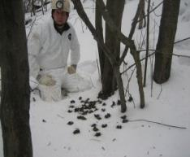
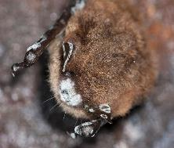
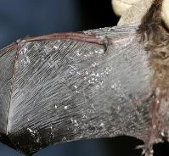
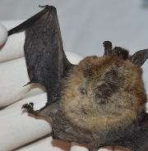
White-nose Syndrome
White-nose syndrome (WNS) discovered 2006/2007 in New York
Fungal disease – causative agent Pseudogymnoascus destructans (Pd)
  Cold loving fungus (4 – 14 ºC, >90% relative humidity)
Killed >6 millions of hibernating bats in Eastern North America
  >90% mortality rate at some hibernacula
Photo: L. Master
Photo: R. Von Linden
Chris 6Anderson
Photo: MI DNR

Slide 3
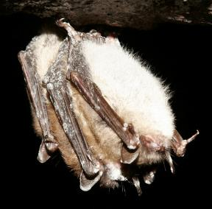
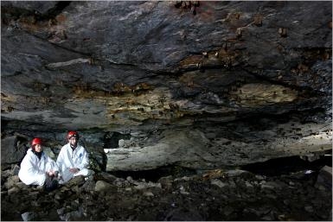
White-nose Syndrome
Transmitted by bat-to-bat or bat-to-environment contact
  Or by humans
Likely introduced from Europe by people
Does not infect humans or other wildlife
USFWS coordinating national response
  whitenosesyndrome.org
Photo: R. Von Linden
Photo: A. Hicks

Slide 4
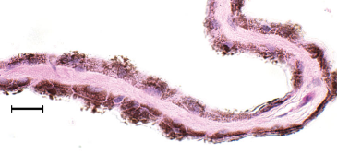
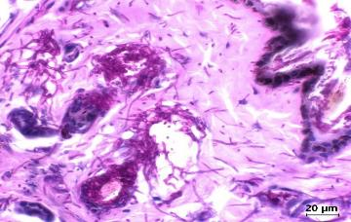
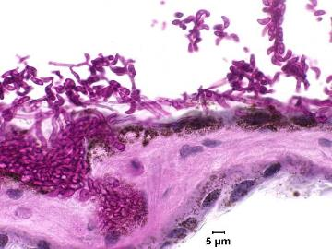
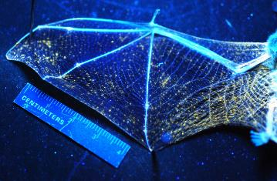
White-nose Syndrome
Wing damage
  Physiological implications
Roused from hibernation
  Starvation

Slide 5
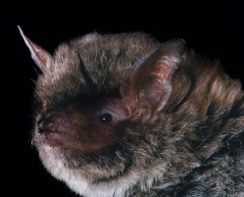
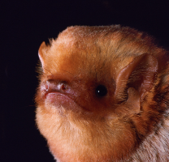
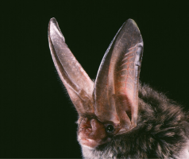
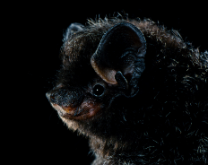
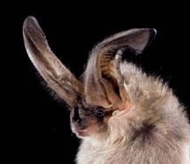
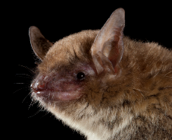
Species Confirmed with pd
Southeastern bat
(Myotis austroriparius)
Eastern red bat
(Lasiurus borealis)
Rafinesque’s big-eared bat
(Corynorhinus rafinesquii)
Silver-haired bat
(Lasionycteris noctivagans)
Townsend’s big-eared bat
(Corynorhinus townsendii)
Cave myotis
(Myotis velifer)
Unknown what other western bat species can transmit Pd
Photos: M. Tuttle

Slide 6
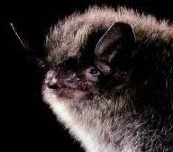
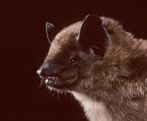
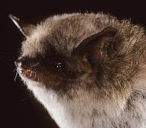
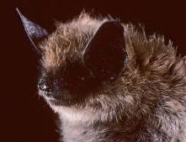
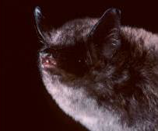
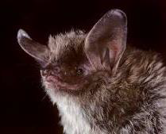
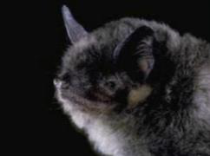
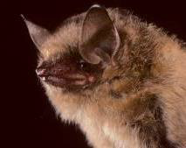
Species Confirmed with WNS
Little brown bat
(Myotis lucifugus)
Big brown bat
(Eptesicus fuscus)
Yuma myotis
(Myotis Yumanesis)
Eastern small-footed bat
(Myotis leibii)
Indiana bat
(Myotis sodalis)
Northern long-eared bat
(Myotis septentrionalis)
Gray bat
(Myotis grisescens)
Tri-colored bat
(Perimyotis subflavus)
Unknown what other western bat species will be impacted
15 species in Washington
Photos: M. Tuttle

Slide 7
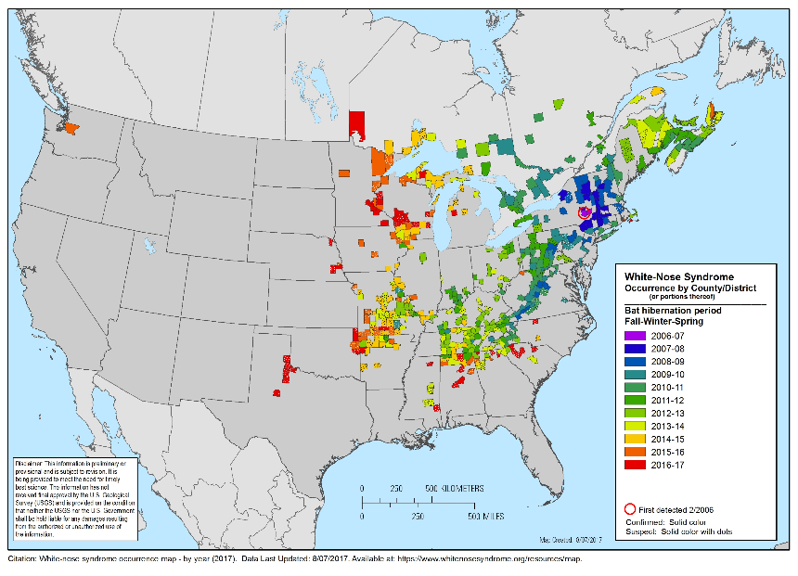
WNS in Washington

Slide 8
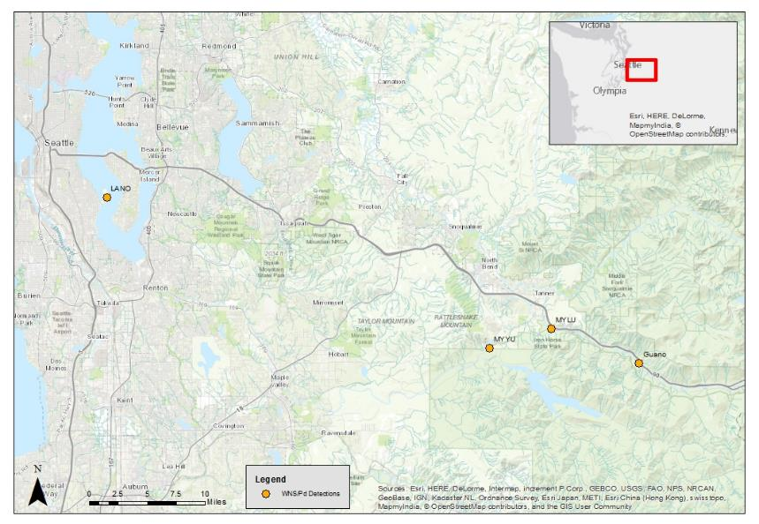




WNS/PD in Washington
March 2016
March 2016
June 2016
April 2017

Slide 9
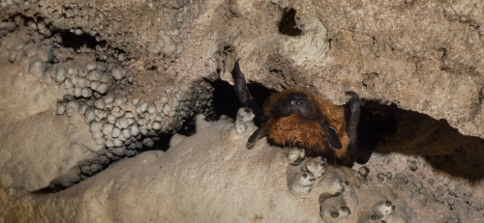
WNS in Washington
Pd genetically similar to eastern strain (Lorch et al. 2016)
How detrimental will WNS be on Washington’s bat populations?
Winter roosting ecology for Washington bat species unclear
  Winter roost selection
  Use of hibernation
  Spring emergence
  Roost microclimate
Photo: M. Tuttle

Slide 10
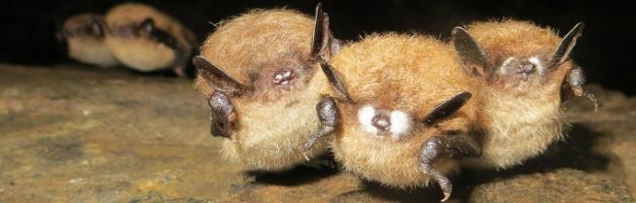
WDFW WNS Response
Key WNS response objectives:
Develop and implement outreach for bats and WNS
Understand the geographic distribution and ecology of WNS in Washington
Elucidate natural life history of Washington bat species and monitor populations
Safeguard bats from sources of WNS mortality and disturbances
Photo: H. Borders

Slide 11
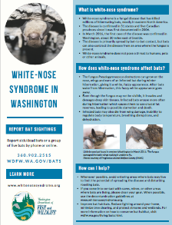
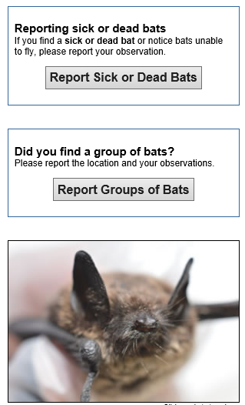
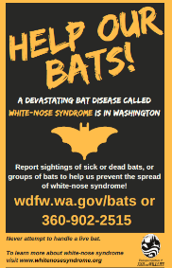
Objective 1: Outreach
Educational materials
  WNS fact sheet
  Help our bats poster
  Species account cards
Online reporting of sick/dead bats or
groups of bats
National Hunting and Fishing Events
Social media (Facebook)
BatWeek
Classroom presentations

Slide 12
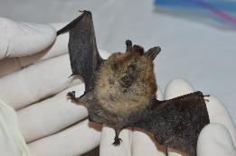
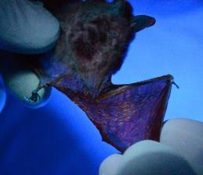
Objective 2: WNS ecology & distribution
Passive Surveillance
  Provided trainings to wildlife rehabilitators
  Presented information to wildlife control operators (WCO)
  57 samples submitted from public reports, wildlife rehabilitators, WCO, and Department of Health from Aug 2016 to June 2017
Developed guidelines for, 1) responding to public bat reports, 2) wildlife rehabilitators, 3) surveillance, 4) capturing bats (in progress), and 5) WNS decontamination
Photo: PAWS
Photo: PAWS

Slide 13
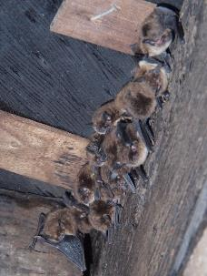
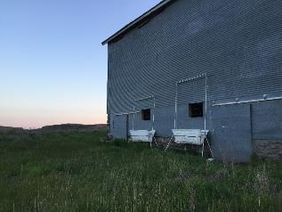
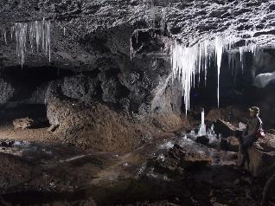
Objective 2: WNS ecology & distribution
Active Surveillance
Sampled 34 sites in 16 counties
Sites include bridges, buildings, abandoned mines, caves, and a bat box
Results from 10 sites are negative for Pd
Results pending for remaining sites
Photo: S. Thomas
Photo: S. Thomas

Slide 14
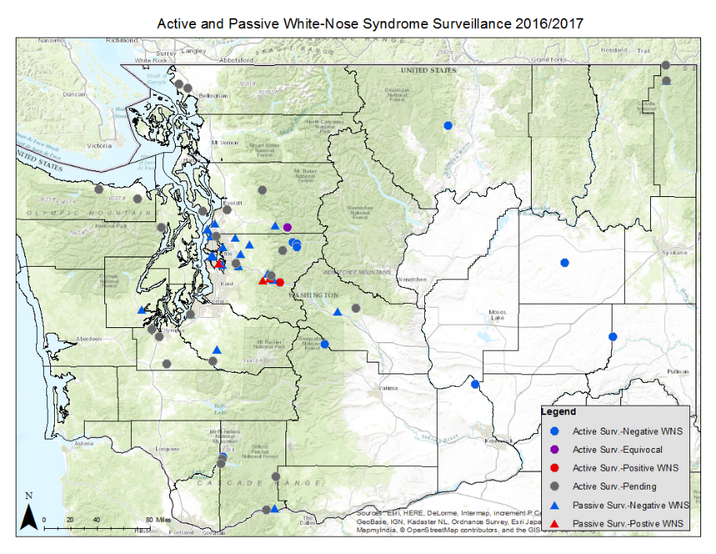

Slide 15
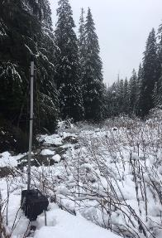
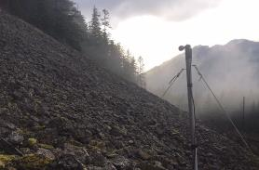
Objective 3: bat life history
Winter Acoustic Monitoring
Determine bat activity patterns and habitat associations to elucidate roosting ecology and guide WNS surveillance
Monitored 25 locations in Snoqualmie River Watershed for a varying amount of time from October to June
Monitored for total of 620 nights
17,988 bat passes occurred during this time
Determined species activity levels and spring emergence
Documented activity at abandoned mine

Slide 16
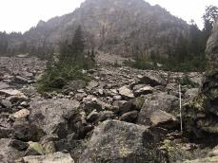
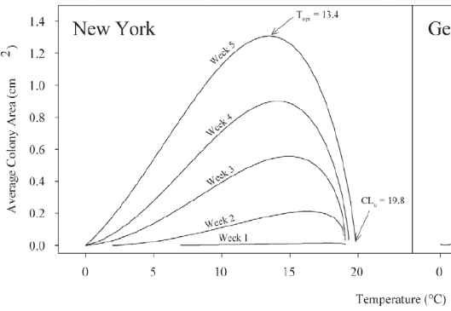
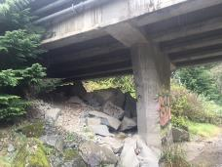
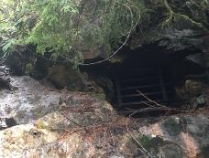
Obj 3: bat life history
Characterize roost microclimate to determine vulnerability of hibernating bats
4 sites monitored for a varying amount of time from October to May
MINE
TALUS
BARN
BRIDGE
Verant et al. 2012

Slide 17
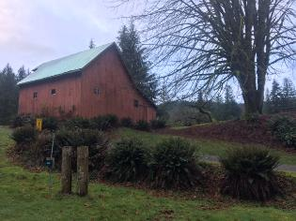
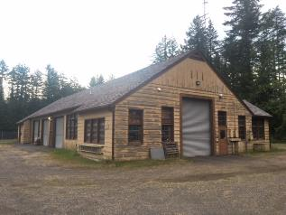
Objective 3: bat natural life history
Maternity Colony Emergence Counts Pilot Season
9 sites counted
Recon required for most
Reassess protocol/strategy for next year

Slide 18
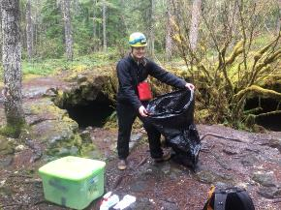
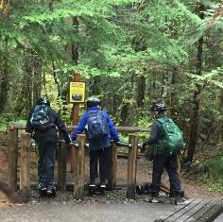
Objective 4: Protect bats
WNS decontamination implemented to limit human assisted spread
    National protocol implemented at subterranean habitat and other high exposure risk roosts
    Developing a modified version of national protocol to be implemented when exposure risk is minimal
        Facilitate cooperation and participation
  Partners (e.g., USFS, State Parks) with cave resources screening and educating visitors about WNS and human assisted spread; boot cleaning stations and mats at popular sites
  Initiate a Bat Health Team

Slide 19
Future Research and Monitoring
Acoustic monitoring
  Extend winter monitoring
Surveillance
  Where is Pd?
  What environments can it persist in PNW?
Winter habitat selection
  Radio telemetry
  Abandoned mine and cave assessments
Maternity colony counts
  Population trends
  Colony health
How can we collaborate? (note: these are project ideas and have not been developed or approved yet)

Slide 20
Acknowledgements
WDFW; Greg Falxa, Joe Buchanan, Lori Salzer, Rachel Blomker, Michelle Tirhi, Ruth Milner, Stefanie Bergh, Fenner Yarborough, Mike Atamian, Jason Fidorra, Anita McMillan, Shelly Ament, Bryan Murphie, Mike Smith, Dana Base, Scott Williams, Ross Huffman, Greg Mackey, Scott Fitkin, Ilai Keren, Treg Christopher, Bill Simper, and Jeff Bernatowicz
USFS/BLM; Northern Research Station (Dan Lindner), Kelli Van-Norman, Josh Chapman, Rob Huff, Sonny Paz, Jesse Plumage, Jason Lowe, Kent Woodruff, Matt Marsh, Monte Kuk, Chelsea Muise, Kurt Aluzas, Karen Holtrop, Cathy Flick, Todd Griffin, and Mitch Wainwright.
State Parks; Crawford State Park, Samammish State Park, Fort Casey Historical Park, Tor Bjorklund, Steve Christensen, Robert Fimbel, Richard Benson
NPS; Tara Chestnut, Mount Rainier National Park, North Cascades National Park, Olympic National Park, San Juan National Historic Site
USFWS; Ann Froschauer, Jenny Barnett, Conboy National Wildlife Refuge
Other; USGS NWHC (Anne Ballmann), UC Davis (Kevin Keel), DOE Hanford Site, Tacoma Public Utilities LaGrande Dam, Evergreen State University Organic Farm, Tumwater Falls Park, Western State Hospital, Whatcom County Hovander Homestead Park, Rexville Grange Venue, Bats Northwest, Thom Proehl (Valley Camp), Sam Pedigo, Bob Davies, and Bat Conservation International

Slide 21
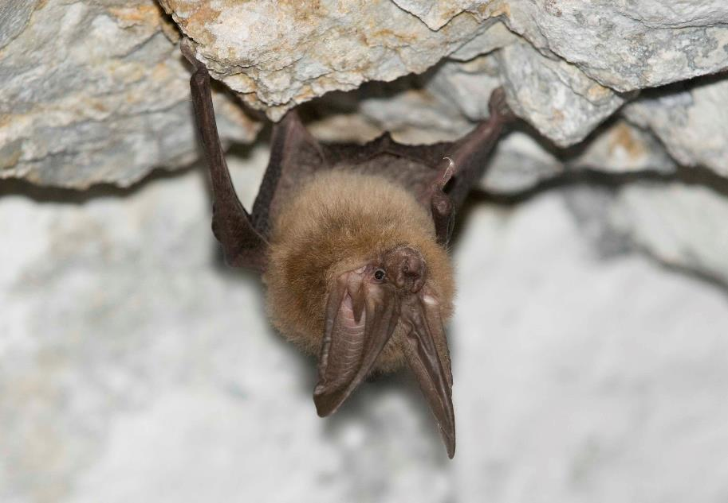
Questions?
Abby Tobin, WNS Coordinator; Abigail.Tobin@dfw.wa.gov
Katie Haman, Wildlife Veternarian; Katherine.Haman@dfw.wa.gov
Lori Salzer, Conservation Biologist; Lori.Salzer@dfw.wa.gov
Joe Buchanan, Bat Species Lead; Joseph.Buchanan@dfw.wa.gov
Photo: B. Davis

